Slide 1
Effects of COVID in New Zealand
By
Track Stars
(Zahid Khan, Perry li,
Jiani Wu, Kaishun Yang)
Notes:
Hello everyone, We are team TRACK STARS, and we decided to analyse the Effects of Covid in New Zealand.

Slide 2
Topics and Contents Covered
Total number of COVID Cases
Vaccines Administered
Crime Rate
Deathrate
Agriculture
GDP (Gross domestic product)
Notes:
As we all know that COVID has had a huge impact on almost every sector of our economy as well as our lives.
We do not have enough time or resources to cover each sector, so we choose 4 topics, which are :
Effects of COVID on CRIME RATE
Effects of Vaccination on DEATH RATE
Effects of COVID in Agriculture sector
And
Effects of COVID on NZ GDP

Slide 3


Data Sources
Covid Data
Ministry of Health NZ (Git Repo)
https://github.com/minhealthnz/nz-covid-data
Vaccination Data
Ministry of Health NZ (Git Repo)
https://github.com/minhealthnz/nz-covid-data
Crime Rate
New Zealand Police statistics
https://www.police.govt.nz/about-us/publications-statistics/data-and-statistics?nondesktop
Death Rate
Ministry of Health NZ (Git Repo)
https://github.com/minhealthnz/nz-covid-data
Notes:
The data collected for Covid Cases, Death rate and Vaccination is from Ministry of health Git-Repository.
Crime Rate statistics were collected from the NZ police website Which was another challenge.

Slide 4

Data Sources
Agriculture
Before Covid:
https://www.stats.govt.nz/information-releases/agricultural-production-statistics-june-2019-final/?fbclid=IwAR2WAR9QR33HcLXF7Nt-JAZZRukfgQiDJhFAukYjOz_HKqKOeQ8kJzxky3c
After Covid:
https://www.stats.govt.nz/information-releases/agricultural-production-statistics-year-to-june-2021-final/?fbclid=IwAR04a29AGmveWZyfI0V9i9yD-5OP68RAazrGrpmOWMw4GRZKpane8jcWjzA
GDP
https://www.stats.govt.nz/information-releases/gross-domestic-product-june-2022-quarter/?fbclid=IwAR1bfYeCwfOSBIp97SkhGlWFzReIxGYD5Q7Fl5jaCmCf3yLqgXgGKbgwjIw
Notes:
For Agriculture and GDP sector the data was collected from Stats NZ

Slide 5
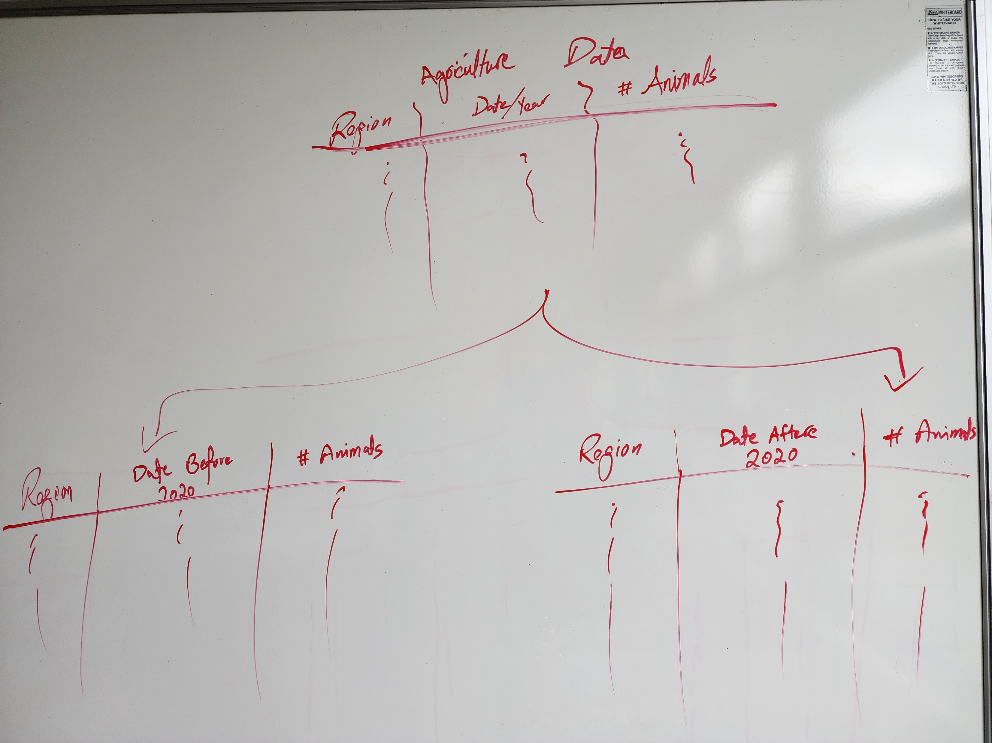
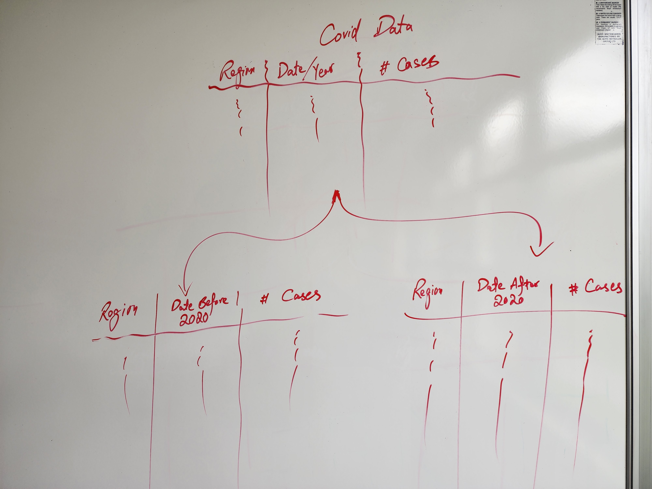
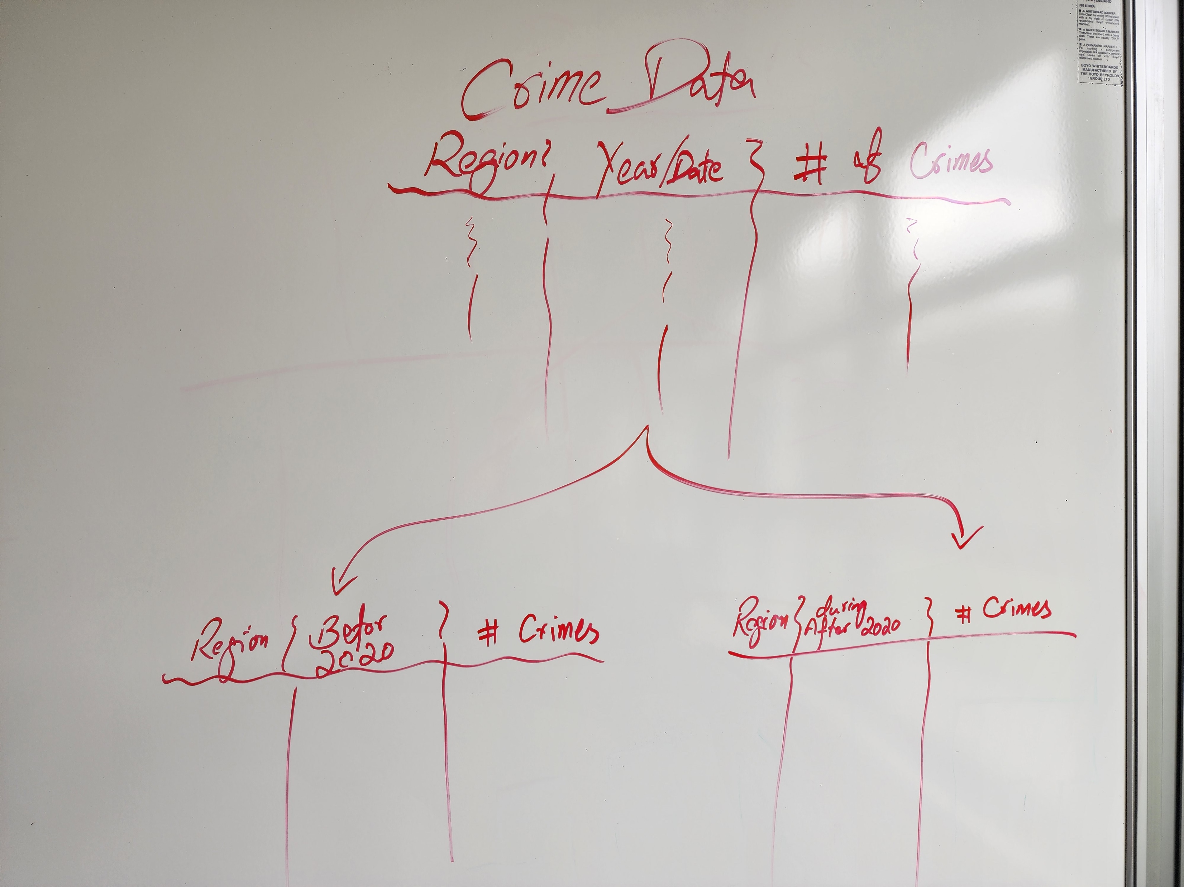
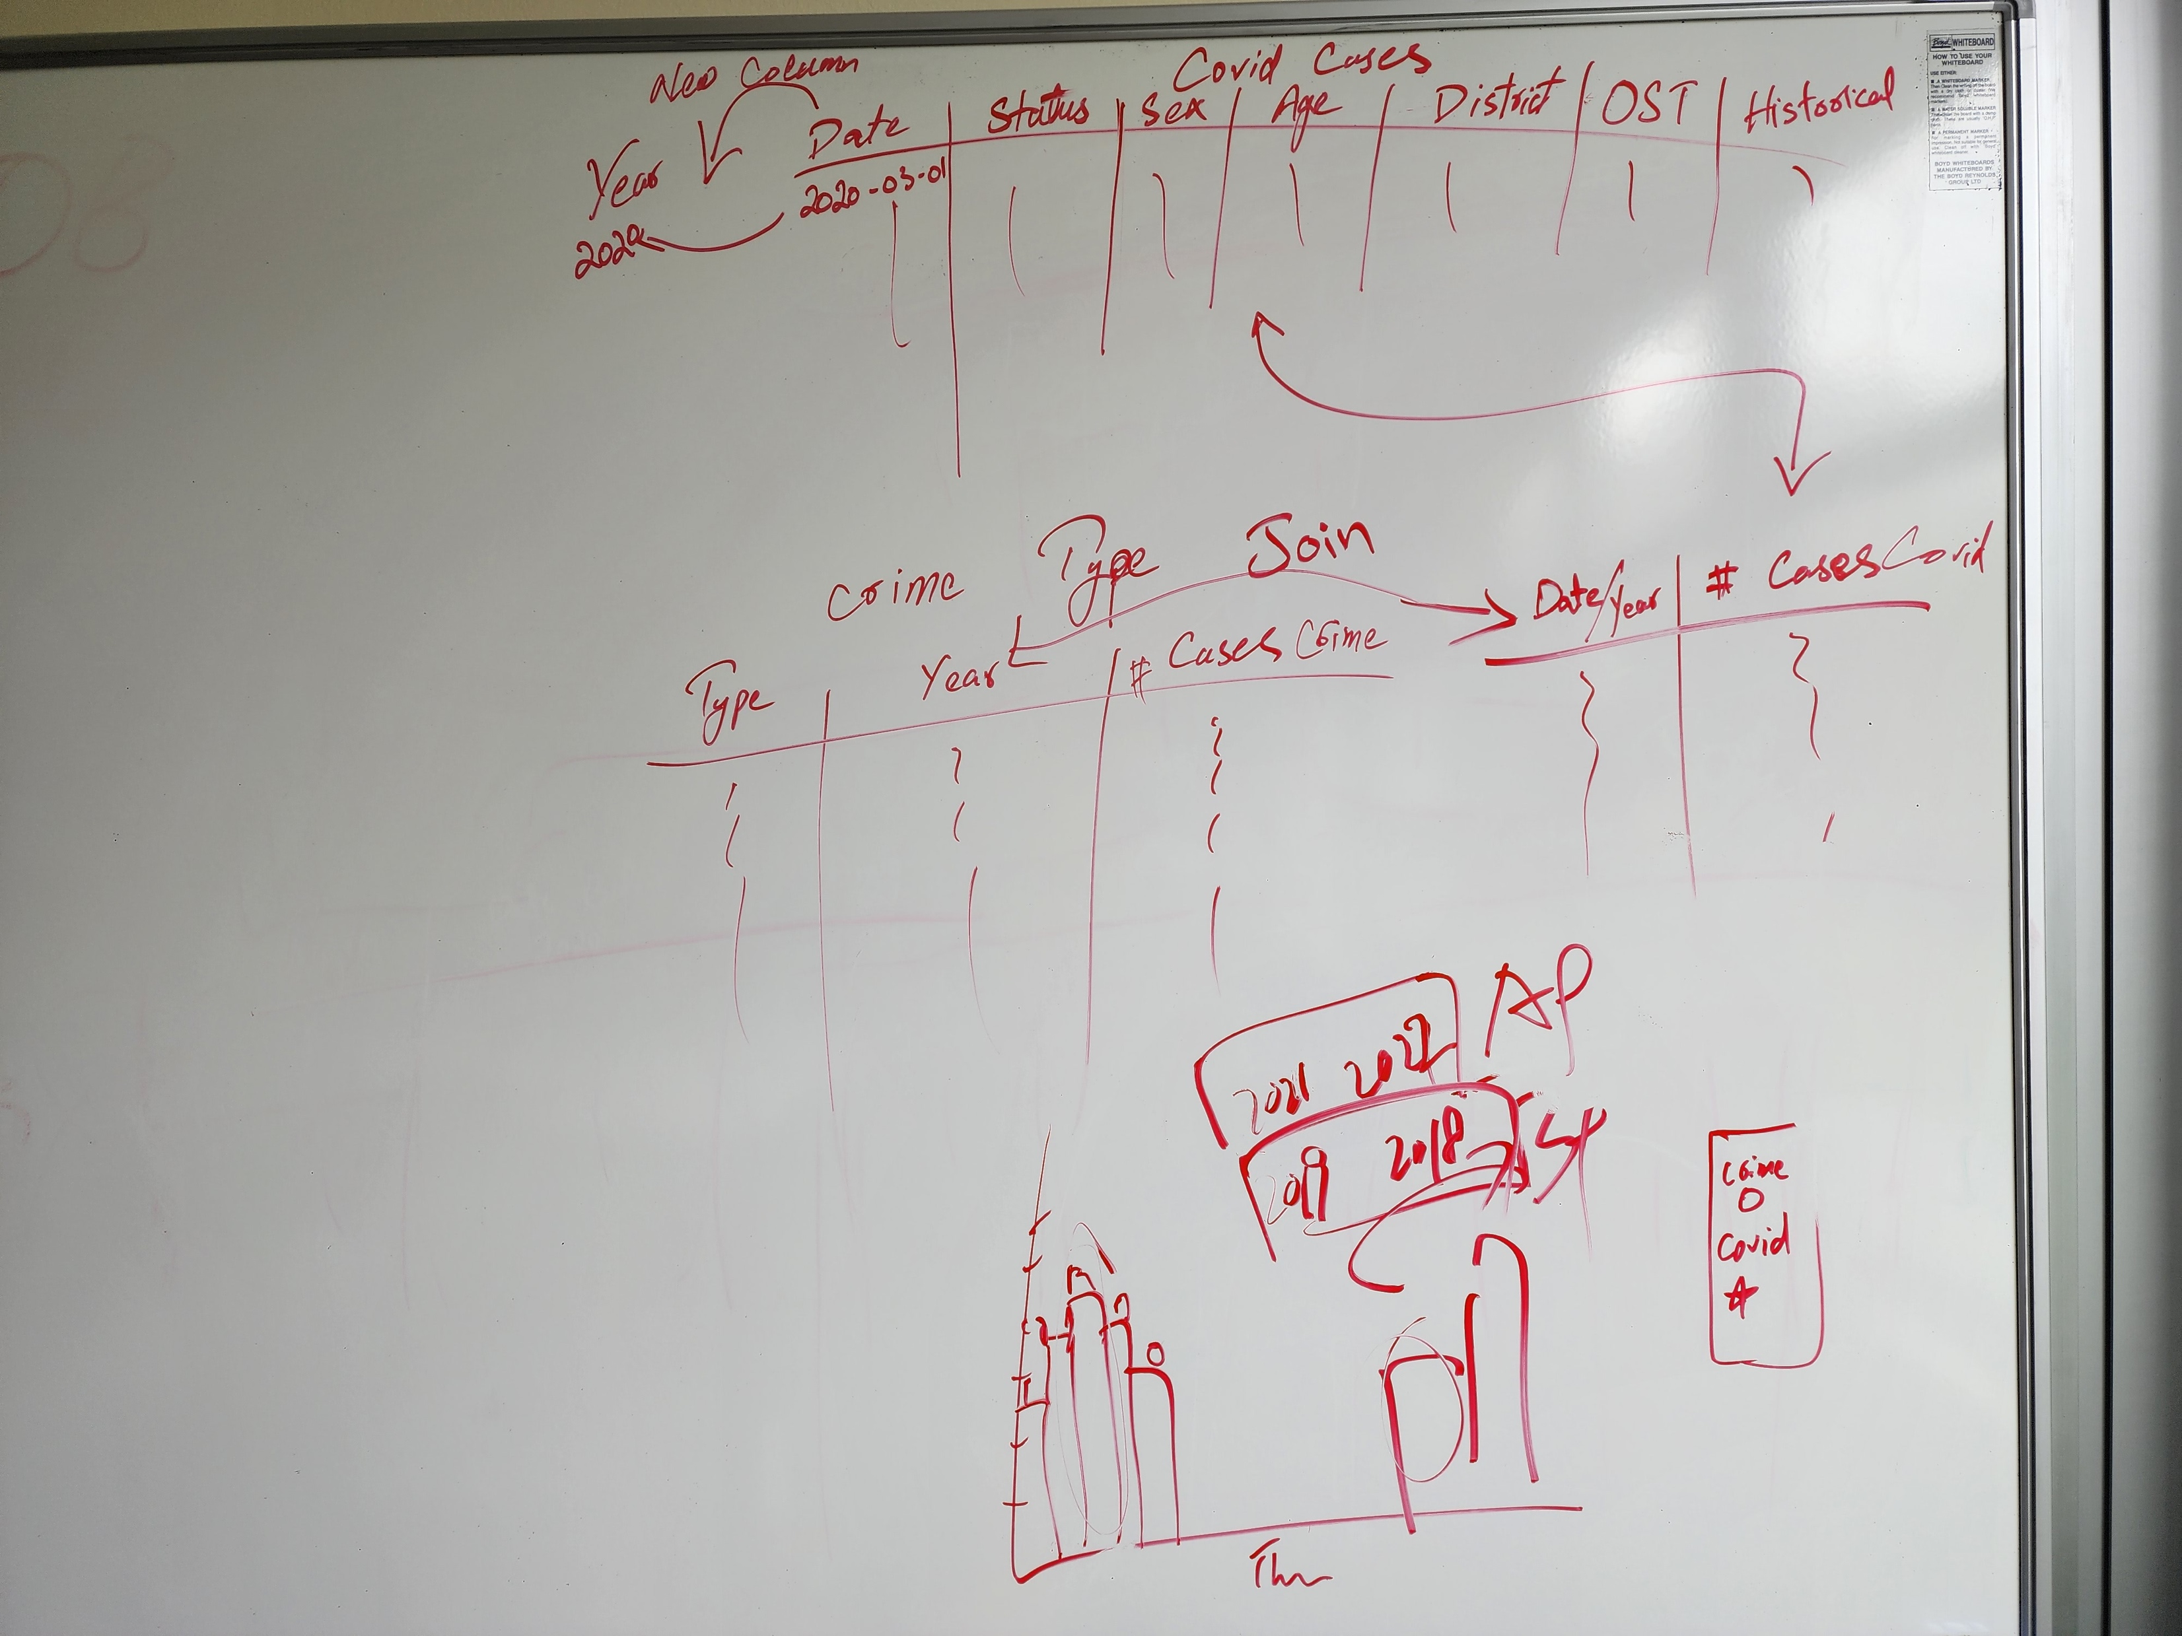
Planning
Notes:
The Major challenge we faced was to collect the CORRECT data.
there is a lot of data available on COVID but not much on how it affects different sectors.
So, we took data for each sector and divided into different periods, e.g., before and after 2020.
Now we got the data but there was even bigger problem, that our data had no common ground to join the datasets on.
Covid data had number of cases on daily bases, vaccination data was in date-range (weekly or so).
Crime data was yearly and was divided into different regions, but once again the region boundary for DHB and Police Districts are different which means most of the Districts didn’t align between COVID and CRIME Dataset.

Slide 6
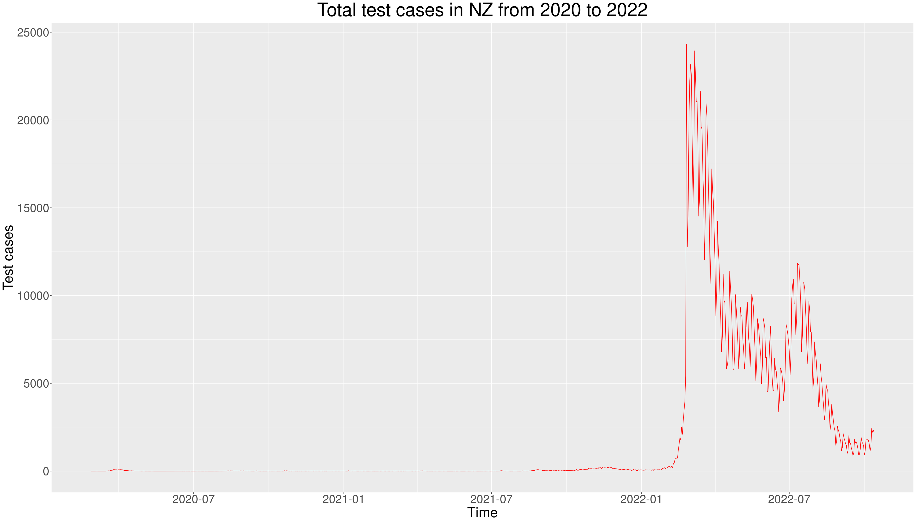
Covid Cases
Zahid Khan
Notes:
The graph on screen shows the Trend line for Covid Cases, As you can see that in the beginning when NZ Govt. was enforcing Lock-downs the number of cases were very low, but in 2022 the number of cases increased dramatically.

Slide 7
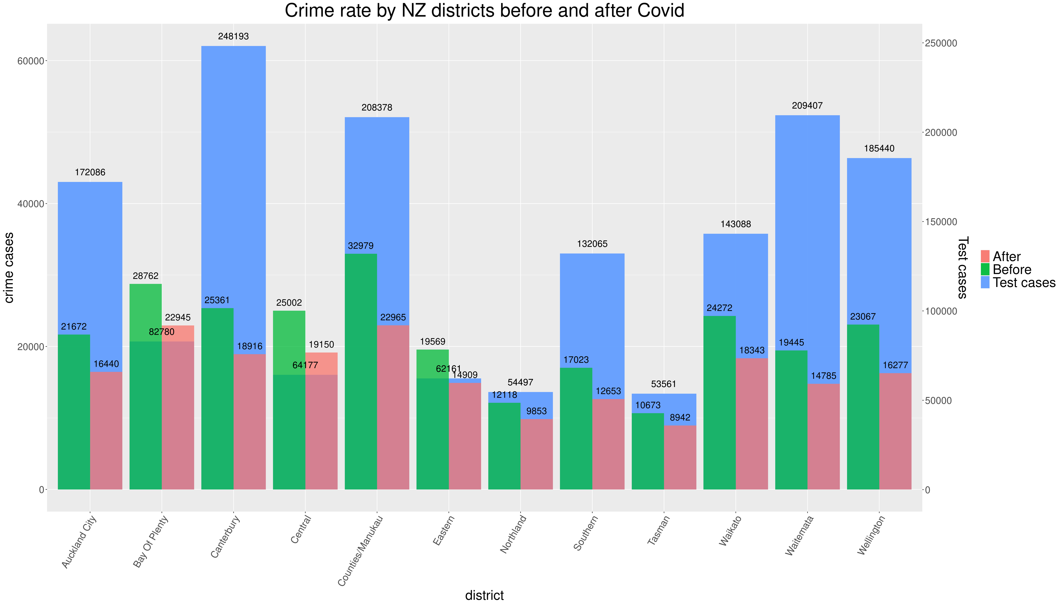
Crime Rate
Zahid Khan
Notes:
As mentioned, earlier, the data from ministry of Health about COVID was a continues data whereas the data for Crime-Data was very discrete, quarterly and yearly values for different regions.
Joining them together was a very big challenge, the only similarity we had between both datasets was regions column, but both datasets used different region boundaries.
To remedy that we had to mutate the names of the districts in COVID dataset, so it matches the Crime Rate dataset, then divide the data into 2 categories before and after covid.
At then end we had 3 different dataset, which were joined together to make one massive dataset. This graph shows the relation between Crime-Rate and Covid.
The blue shows the total number of Covid cases per region, whereas the green and red shows the crime-rate before and after the covid.
As you can see that the crime rate has dropped after COVID, and we think it was due to all the lock-down and restrictions imposed by Govt, due to COVID.

Slide 8
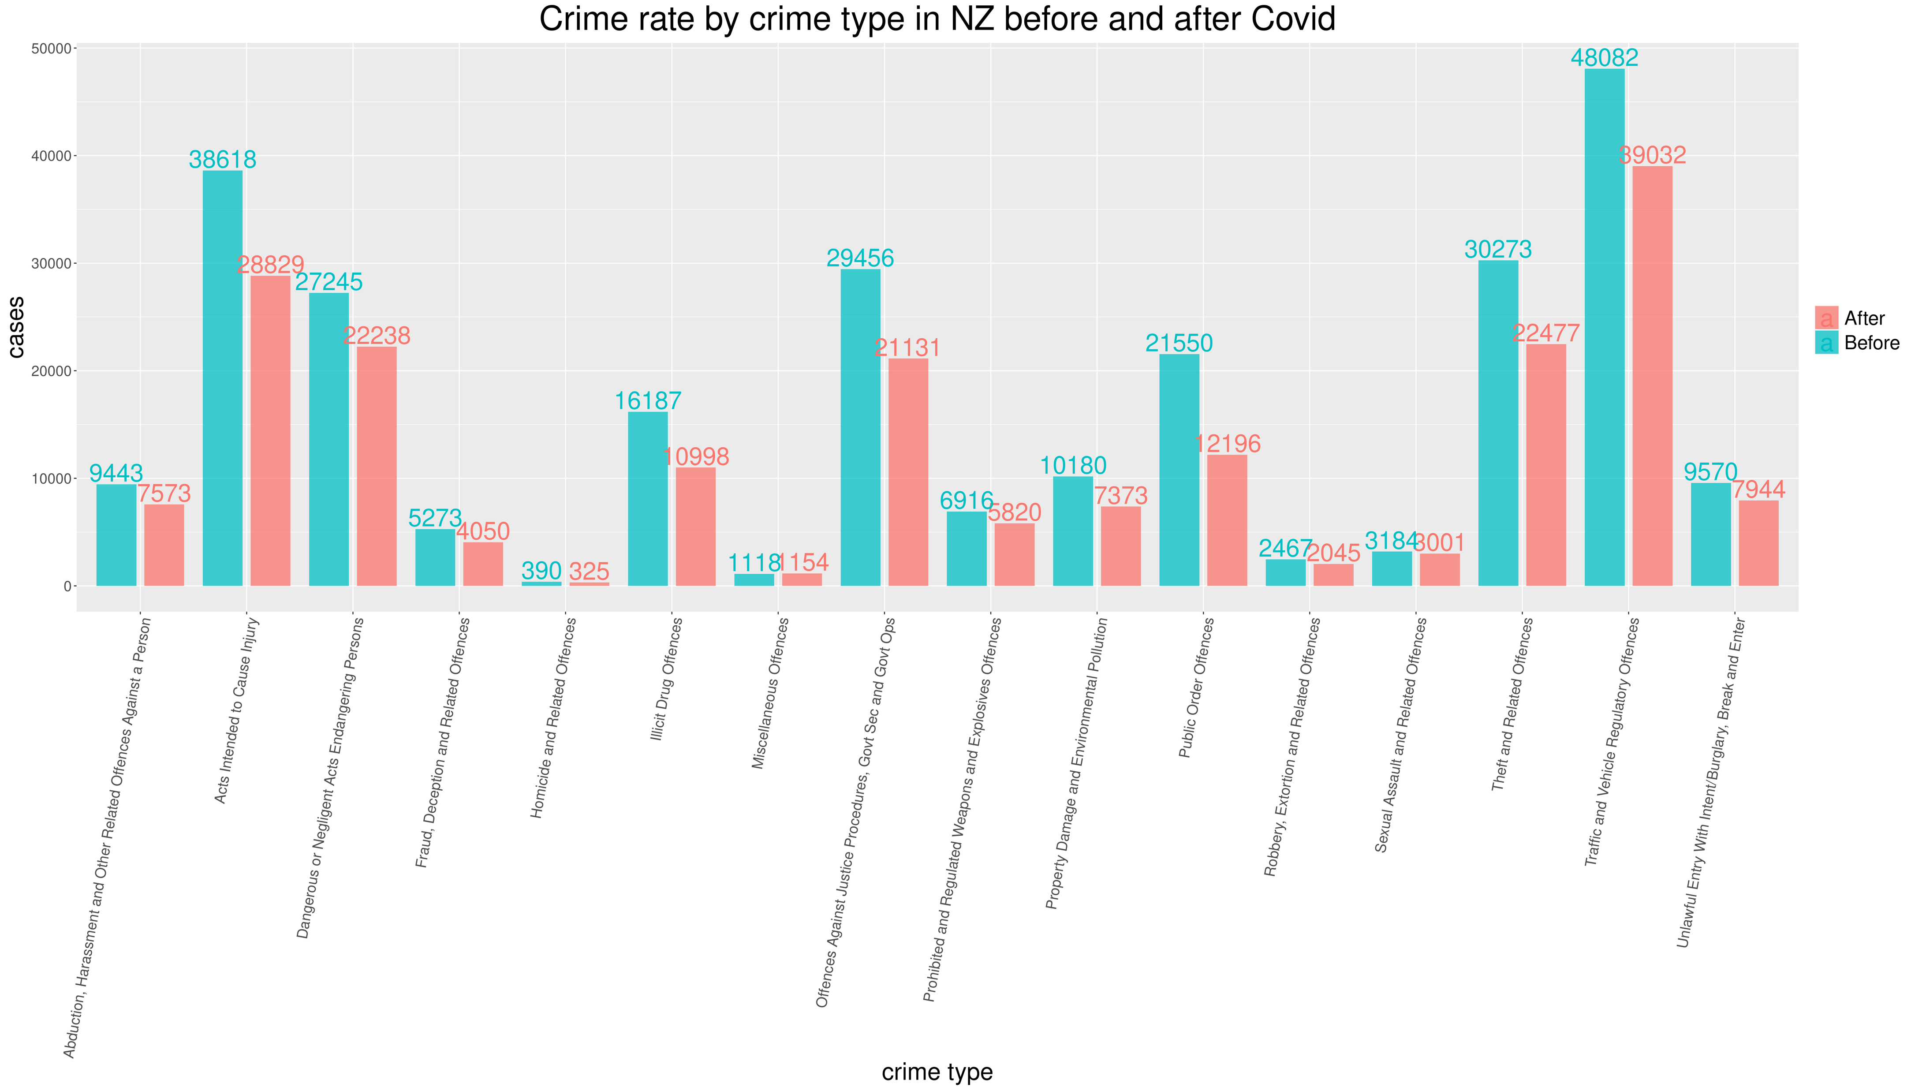
Crime Rate
Zahid Khan
Notes:
We have also wrangled the data for total number of

Slide 9
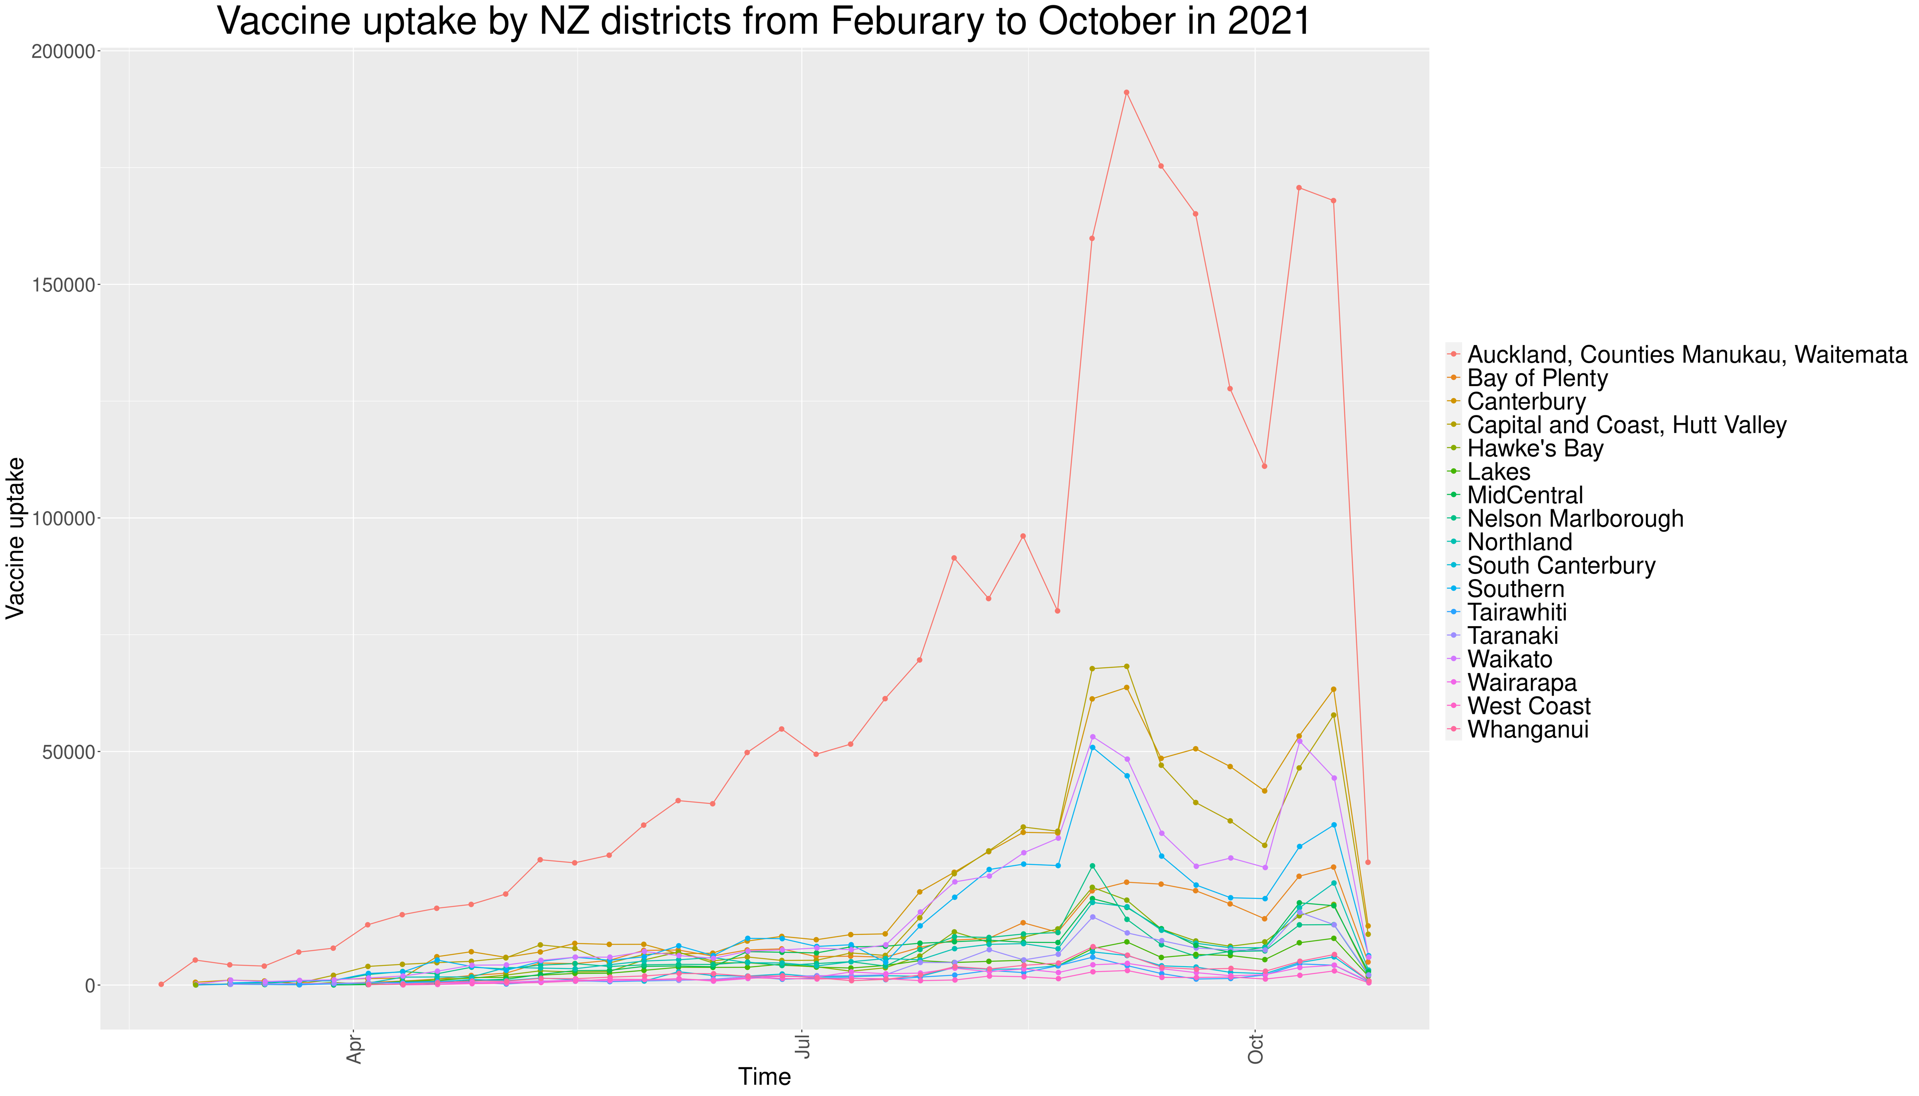
Vaccine Rate
Kaishun (Ted) Yang

Slide 10
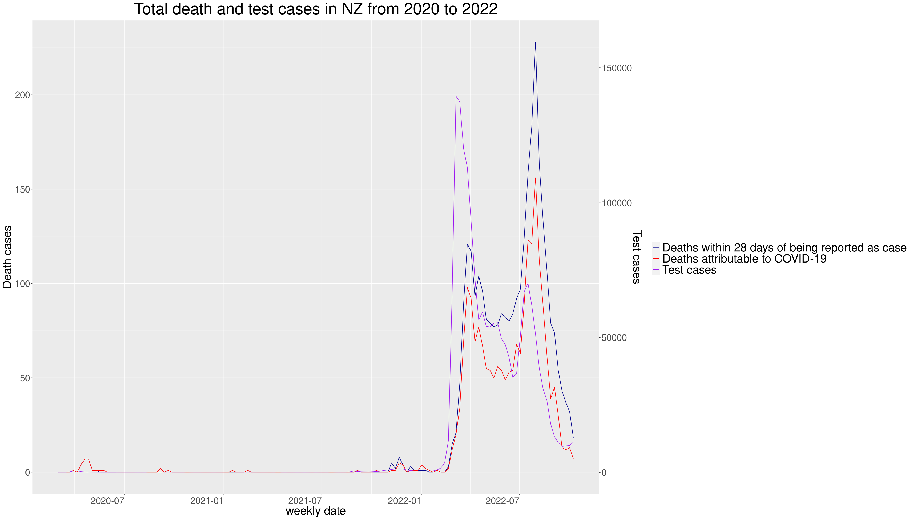
Death Rate
Kaishun (Ted) Yang

Slide 11
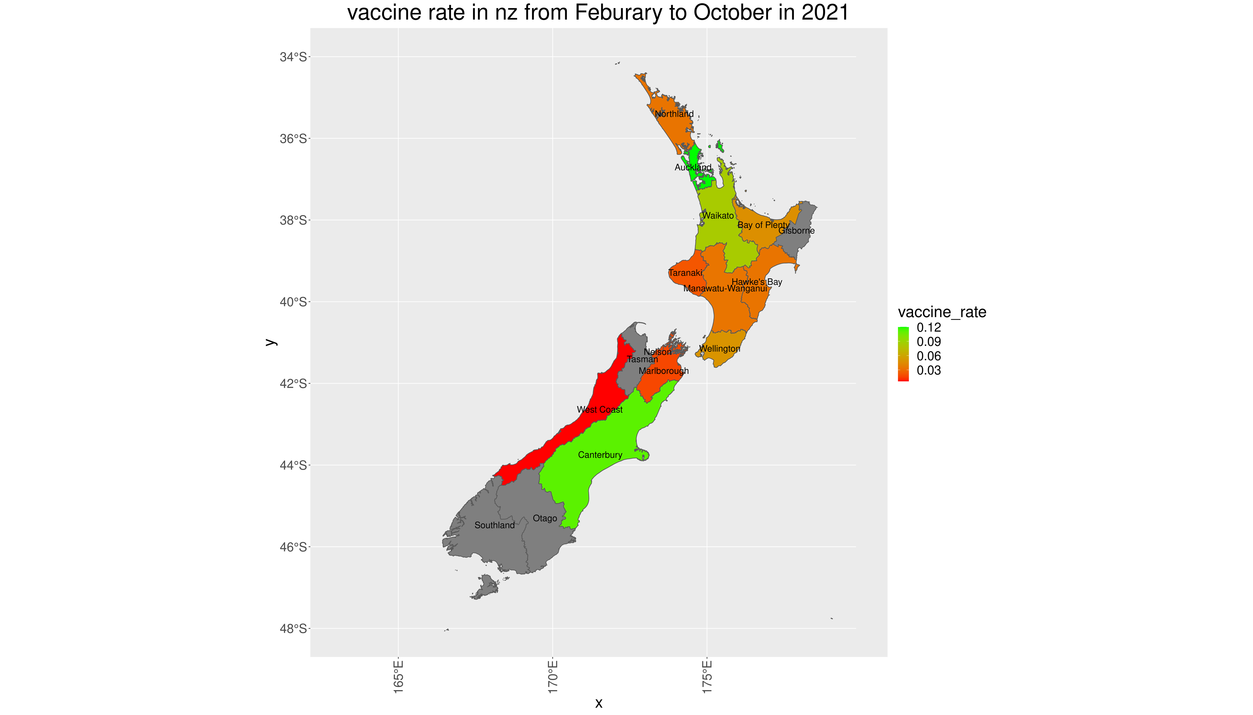
Vaccine Rate
Kaishun (Ted) Yang

Slide 12
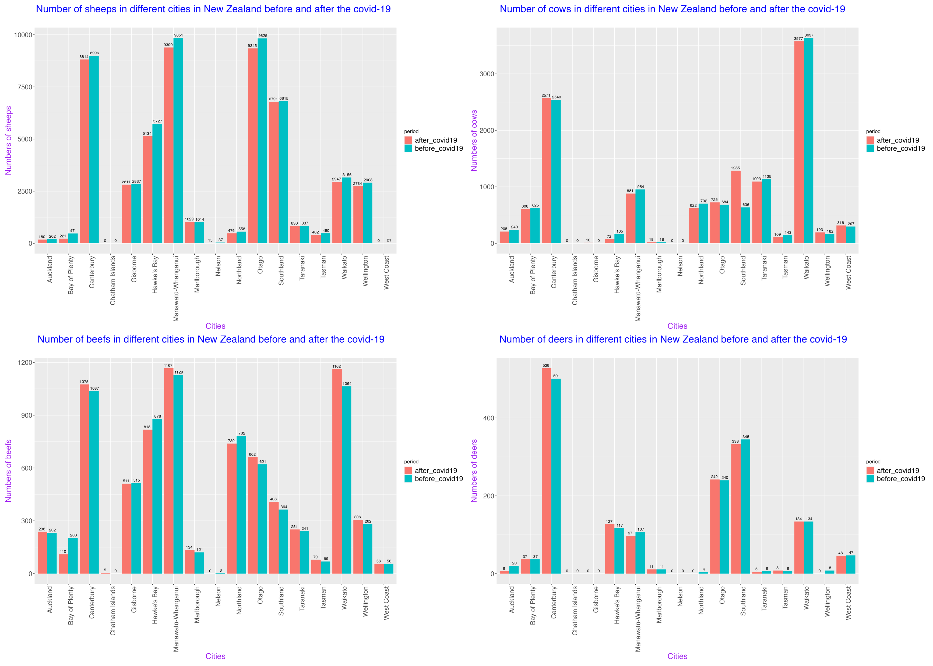
Agriculture
Jiani (Norie) Wu
Notes:
1.From the sheep comparison graph, every cities in NZ has a slight reduction about numbered of sheep after covid,
2.From the cow's comparison graph, cities in NZ there are 8 cities experienced a decreasing in number of cows after covid
3.From the beef comparison graph , the quantities of beefs keep raising in 80 percentage of cities in NZ , so a little influence on the number of beef cattle in NZ after the outbreak
4. Only 5 cities are influenced into a reducing trends
Overall, from my data , this are a small bad impact on the number of the livestock before and after covid-19 , only sheep quantities got little reduction on every city

Slide 13
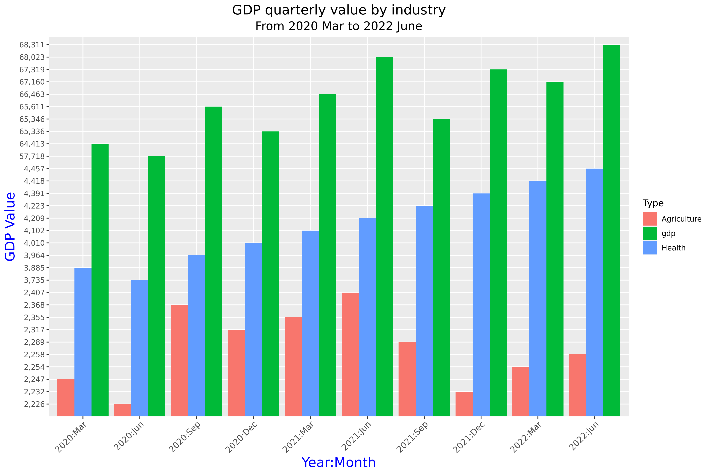
GDP
Pei (Perry) Li
Notes:
I used table for quarterly changes in GDP, from January 1987 to June 2022. In order to observe the impact of covid-19 on GDP, I intercepted data from March 2020 to June 2022.
As my teammates analysed the impact of covid-19 on agriculture and healthcare, I also compared GDP changes in these industry.
As we can see in the graph, health GDP shows a continuous upward trend. Agricultural GDP saw a huge reduction in the first few months of covid-19, which coincided with the start of New Zealand's lockdown After the end of the lockdown in September 2020, agricultural GDP started to grow up until the lockdown started again in August 2021.

Slide 14
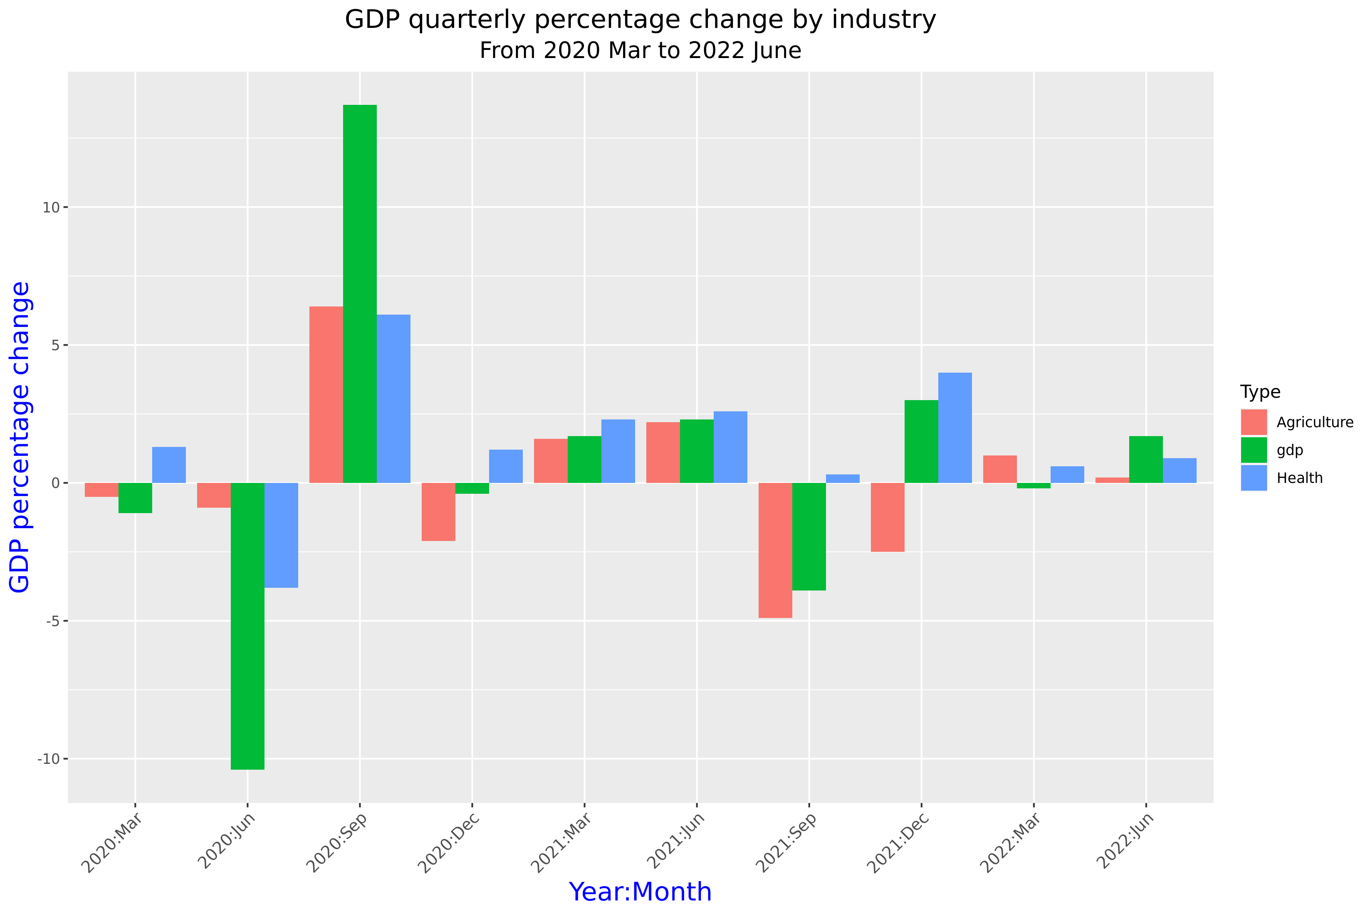
GDP
Pei (Perry) Li
Notes:
The second graph shows the quarterly percentage change in GDP. As we can see in the graph, from March to July 2020, GDP decreased significantly. During this time, the virus was raging all over the world, and New Zealand went into lockdown.
In September 2020, after the lockdown ended, there was a significant increase in GDP.
In September 2021, the number of covid-19 cases were rising again, and New Zealand went into a second lockdown. Both total and agricultural GDP declining, until in December 2021. Except of health GDP, which stayed positive through out the pendamic.

Slide 15
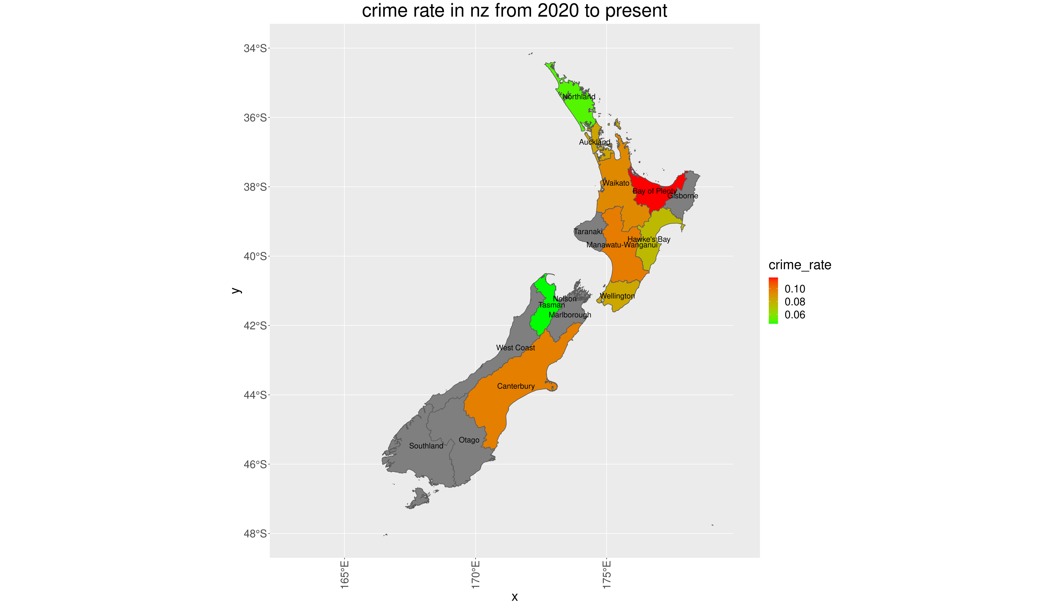
Extra
Notes:
As we have seen that

Slide 16
Conclusion
Covid has hugely influenced every sector in New Zealand
Crime Rate has gone down – Positive
NZ Economy has suffered – Negative
NZ Health has suffered – Negative
Very little growth in Agriculture - Negative
Notes:
As we have seen that

Slide 17
Q&A
Add New Zealand Map Here…

Slide 18
Thank You
Honourable Mentions:
Teaching Team
Tutoring Team
Classmates
Thank you for your help, support and exchange of ideas through out the course.

